Slide 1
Topic 2
Brute Force
Prof. Hanan Elazhary
Main source: A. Levitin, Introduction to the Design and Analysis of Algorithms, 3rd edition

Slide 2
Brute Force
A straightforward approach to solving a problem (algorithm design strategy), usually based directly on the problem statement and definitions of the concepts involved
Examples:
Computing a^{n} (a > 0, n a nonnegative integer)
Computing n!
Multiplying two matrices
Searching for a key of a given value in a list
This strategy refers to the force of the computer
Often, this is the easiest strategy to apply

Slide 3
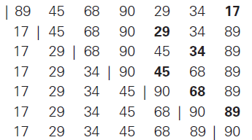
Example 1: Selection Sort
Explanation of the algorithm
Find the smallest element in the unsorted portion of the array.
Swap it with the first unsorted element.
Move the boundary of the sorted portion (increment the index of the sorted part).
Repeat steps 1–3 for the remaining unsorted portion until the entire array is sorted.
Sorting a list containing 89, 45, 68, 90, 29, 34, 17

Slide 4
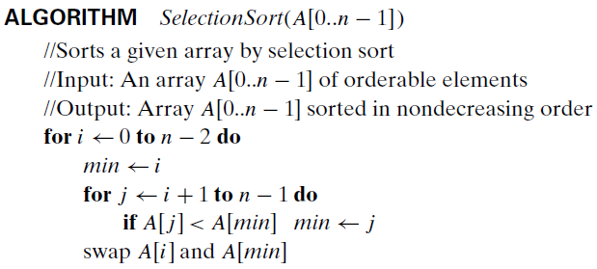

Example 1: Selection Sort, Contd.
The algorithm
From the first element to the one before the last, …
start a new iteration with the current element considered the minimum
From the following item to the last, …
keep searching for any smaller
At the end of the iteration, swap the current with the minimum

Slide 5
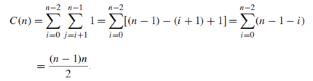
Example 1: Selection Sort, Contd.
Analysis of the algorithm
The input size is n, the basic operation is comparison, one case
Time efficiency is

Slide 6
Example 2: Bubble Sort
Explanation of the algorithm
Compare adjacent elements in the array.
Swap them if they are in the wrong order.
After each pass, the largest element "bubbles up" to its correct position.
Repeat steps 1–3 for the remaining unsorted portion of the array until no swaps are needed.
.
Example: Sorting a list containing 89, 45, 68, 90, 29, 34, 17 | Step 1: First Pass (Bubble the largest element to the end) [45, 89, 68, 90, 29, 34, 17] [45, 68, 89, 90, 29, 34, 17] [45, 68, 89, 90, 29, 34, 17] [45, 68, 89, 29, 90, 34, 17] [45, 68, 89, 29, 34, 90, 17] [45, 68, 89, 29, 34, 17, 90] After the first pass, the largest element 90 has bubbled up to the end of the list | Step 2: Second Pass (Bubble the next largest element) [45, 68, 89, 29, 34, 17, 90] [45, 68, 89, 29, 34, 17, 90] [45, 68, 29, 89, 34, 17, 90] [45, 68, 29, 34, 89, 17, 90] [45, 68, 29, 34, 17, 89, 90] After the second pass, 89 is in its correct position | Step 2: Third Pass (Bubble the next largest element …….

Slide 7
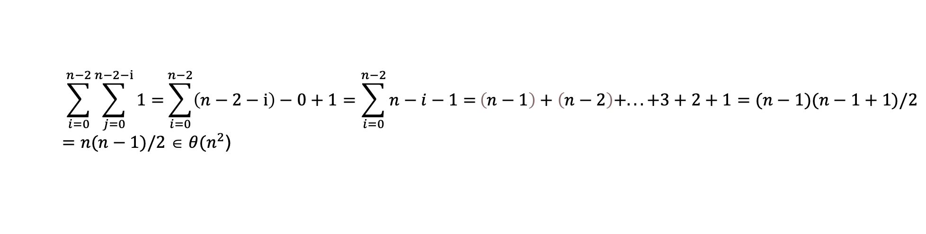
Example 2: Bubble Sort, Contd.
Analysis of the algorithm
The input size is n, the basic operation is comparison, one case
Time efficiency is
$$\sum_{i=0}^{n−2}{\sum_{j=0}^{n−2−i}{1=}}\sum_{i=0}^{n−2}{\left(n−2−i\right)−0+1}=\sum_{i=0}^{n−2}{n−i−1=}\left(n−1\right)+\left(n−2\right)+...+3+2+1=(n−1)(n−1+1)/2=n(n−1)/2 \text{∈} θ(n^{2}\text{)}$$
ALGORITHM BubbleSort(A[0..n-1])
// Sorts a given array by bubble sort
// Input: An array A[0..n-1] of orderable elements
// Output: Array A[0..n-1] sorted in nondecreasing order
for i ← 0 to n - 2 do
for j ← 0 to n - 2 - i do
if A[j] > A[j + 1] then
Swap A[j] and A[j + 1]

Slide 8
Example 2: Insertion Sort
Explanation of the algorithm
Start from the second element (key) in the array.
Compare the key with the elements in the sorted portion of the array (left side) and shift the larger elements to the right.
Insert the key into its correct position in the sorted portion.
Repeat steps 1–3 for the next element until the entire array is sorted.
.

Slide 9
Example 2: Insertion Sort, Contd.
Example: Sorting a list containing [ 89, 45, 68, 90, 29, 34, 17]
First Pass (i = 1): Key = 45 Compare 45 with 89: Since 45 < 89, shift 89 to the right. Insert 45 in the correct position: [45, 89, 68, 90, 29, 34, 17] | Third Pass (i = 3): Key = 90 Compare 90 with 89: No shift needed. [45, 68, 89, 90, 29, 34, 17] | Fifth Pass (i = 5): Key = 34 Compare 34 with 90: Shift 90 to the right. Compare 34 with 89: Shift 89 to the right. Compare 34 with 68: Shift 68 to the right. Compare 34 with 45: Shift 45 to the right. Insert 34 in the correct position: [29, 34, 45, 68, 89, 90, 17]
Second Pass (i = 2): Key = 68 Compare 68 with 89: Since 68 < 89, shift 89 to the right. Insert 68 in the correct position [45, 68, 89, 90, 29, 34, 17] | Fourth Pass (i = 4): Key = 29 Compare 29 with 90: Shift 90 to the right. Compare 29 with 89: Shift 89 to the right. Compare 29 with 68: Shift 68 to the right. Compare 29 with 45: Shift 45 to the right. Insert 29 in the correct position: [29, 45, 68, 89, 90, 34, 17] | Sixth Pass (i = 6): Key = 17 Compare 17 with 90: Shift 90 to the right. Compare 17 with 89: Shift 89 to the right. Compare 17 with 68: Shift 68 to the right. Compare 17 with 45: Shift 45 to the right. Compare 17 with 34: Shift 34 to the right. Compare 17 with 29: Shift 29 to the right. Insert 17 in the correct position [17, 29, 34, 45, 68, 89, 90]
.

Slide 10
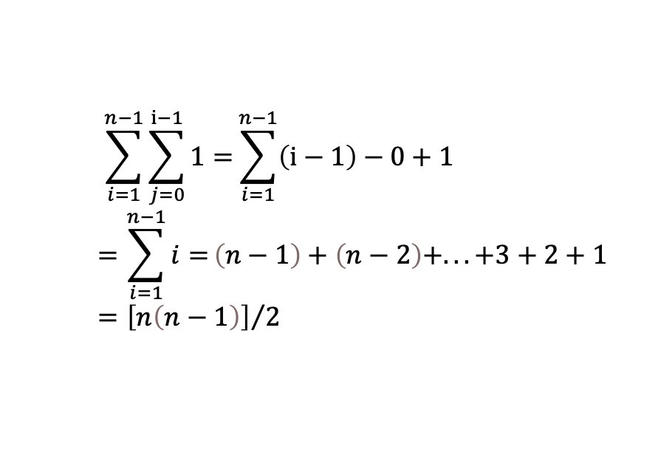
Example 2: Insertion Sort, Contd.
Analysis of the algorithm
The input size is n, the basic operation is comparison, one case
Time efficiency is
$$\sum_{i=1}^{n−1}{\sum_{j=0}^{i−1}{1=}}\sum_{i=1}^{n−1}{\left(i−1\right)−0+1}=\sum_{i=1}^{n−1}{i=}\left(n−1\right)+\left(n−2\right)+...+3+2+1={\left[n\left(n−1\right)\right]}/2$$
ALGORITHM InsertionSort(A[0..n-1])
// Sorts a given array by insertion sort
// Input: An array A[0..n-1] of orderable elements
// Output: Array A[0..n-1] sorted in nondecreasing order
for i ← 1 to n - 1 do
key ← A[i] // Store the current element
j ← i - 1 // Start from the last sorted element
while j ≥ 0 and A[j] > key do // Shift elements greater than key to the right
A[j + 1] ← A[j]
j ← j - 1
A[j + 1] ← key // Insert the key at its correct position

Slide 11

Example 3: String Matching
Explanation of the problem
pattern: a string of m characters to search for
text: a (longer) string of n characters to search in
problem: find a substring in the text that matches the pattern

Slide 12

Example 3: String Matching, Contd.
Explanation of the algorithm
Step 1: Align pattern at beginning of text
Step 2: Moving from left to right, compare each character of pattern to the corresponding character in text until
all characters are found to match (successful search); or
a mismatch is detected
Step 3: While pattern is not found, and the text is not yet exhausted, realign pattern one position to the right and
repeat Step 2

Slide 13
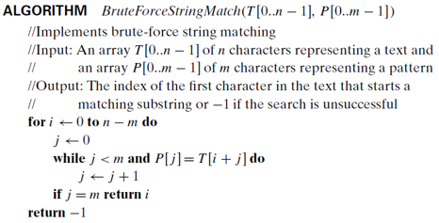

Example 3: String Matching, Contd.
The algorithm
From the beginning of the text till (n-1) – m + 1 (the last character that can begin a pattern)
From the beginning of the pattern …
till m-1 provided matching is TRUE
If we finished a full match, return index of first matching character in text
13

Slide 14
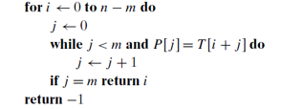
Example 3: String Matching, Contd.
Analysis of the algorithm
The basic operation is comparison, more than one case
In the worst case, for each n-m+1 tries, we make m comparisons (at maximum)
Time efficiency is Θ(mn) comparisons (in the worst case)
14
Notes:
We compute Theta in the worst case and not Big O since we are considering cases not solutions

Slide 15
Example 4: Closet Pair Problem
Explanation of the problem
find the two closest points in a set of n points (in the two-dimensional Cartesian plane)
Explanation of the algorithm
Compute the distance between every pair of distinct points
and return the indexes of the points for which the distance is the smallest

Slide 16
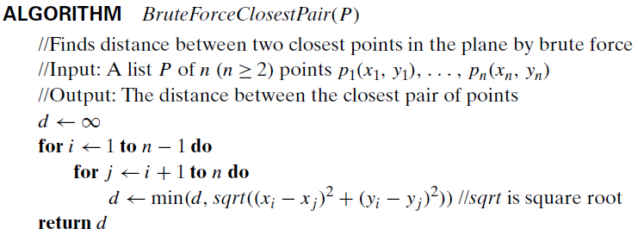
Example 4: Closet Pair Problem, Contd.
The algorithm
Starting from the first point to the one before the last, …
for every other following point (in the list)
Notes:
Pythagoras method is most related to Euclidean distance

Slide 17
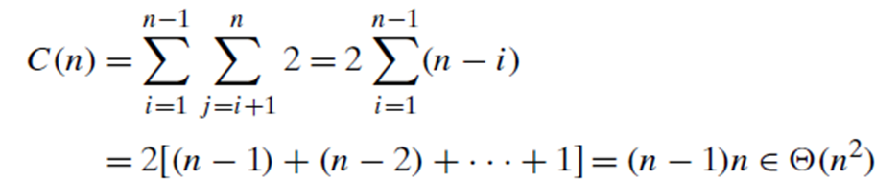
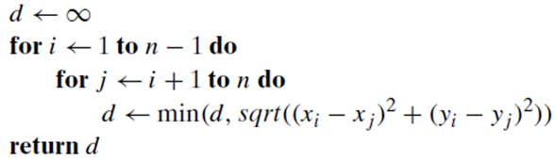

Example 4: Closet Pair Problem, Contd.
Analysis of the algorithm
The basic operation is the square root (a complicated operation) and 2 multiplications, but we can ignore the square root and compute it once at the end (why)
Time efficiency is
Divide-and-conquer approach can make it faster!
Notes:
One can avoid computing square roots by comparing distance squares instead. In that case square root will be needed only once after the loop is terminated.

Slide 18
Strengths and Weaknesses of Brute Force
Strengths
simplicity
wide applicability
yields reasonable algorithms for some important problems (e.g., matrix multiplication, sorting, searching, string matching)
Weaknesses
rarely yields efficient algorithms
some brute-force algorithms are unacceptably slow
not as constructive (creative) as some other design strategies

Slide 19
Exhaustive Search

Slide 20
Exhaustive Search
A brute force approach for solving a problem
involving search for an element with a special property among all possible solutions
usually when we have combinatorial objects such as permutations, combinations, or subsets of a set
Method:
generate a list of all potential solutions to the problem in a systematic manner
evaluate potential solutions one by one, disqualifying infeasible ones and,
for an optimization problem, keeping track of the best one found so far
and when search ends, announce the solution(s) found
Notes:
Permutations: Order matters, used when arranging elements.
Example: For the set {A,B,C}, the permutations of choosing 2 elements are AB, AC, BA, BC, CA, and CB.
Combinations: Order does not matter, used when choosing elements.
Example: For the set {A,B,C}, the combinations of choosing 2 elements are AB, AC, and BC. (Order does not matter here.)
Subsets: All possible collections of elements, including none or all of them.
Example: For the set {A,B,C}, the subsets are ∅, {A}, {B}, {C}, {A,B}, {A, B}, {A,C}, {B,C}, and {A,B,C}.

Slide 21
Example 1: Traveling Salesman Problem
Explanation of the problem
Given n cities with known distances between each pair, find the shortest tour that passes through all cities exactly once before returning to the starting city
Alternatively, find shortest Hamiltonian circuit in a weighted connected graph
2
A Hamiltonian circuit is defined as a cycle that passes through all the vertices of the graph exactly once
a
b
5
3
8
4
c
d
7

Slide 22
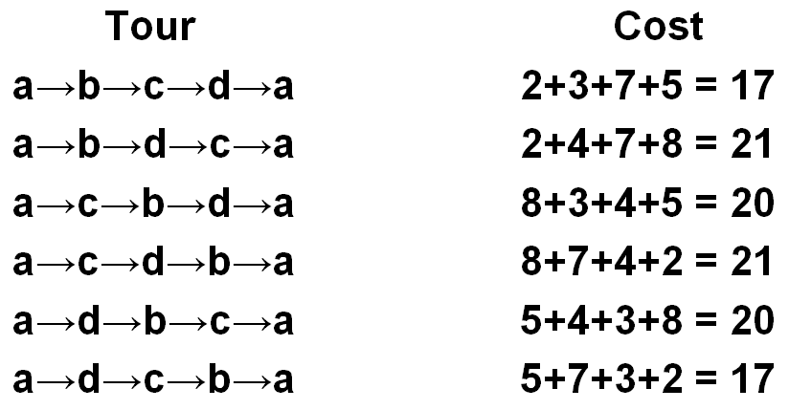
Example 1: Traveling Salesman Problem, Contd.
Explanation of the algorithm
Analysis of the algorithm
Time efficiency is
2
a
b
5
3
8
4
c
d
7
Number of permutations in TSP is (n-1)! excluding city of interest

Slide 23
Example 2: Knapsack Problem
Explanation of the problem
Given n items
weights w₁ w₂ … w_{n}
values v₁ v₂ … v_{n}
and a knapsack of capacity W
find most valuable subset of the items that fit into the knapsack
and the corresponding optimal value
Example: Knapsack capacity W=16
item weight value
2 $20
5 $30
10 $50
5 $10

Slide 24
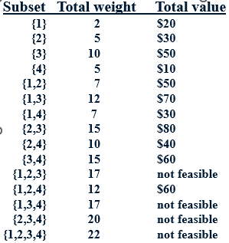

Example 2: Knapsack Problem, Contd.
Explanation of the algorithm
Analysis of the algorithm
Time efficiency
Example: Knapsack capacity W=16
item weight value
2 $20
5 $30
10 $50
5 $10
Each subset can be represented by a binary string (bit vector, Ch 5)
Notes:
Number of subsets is 15 (excluding empty subset)
Omega(2^n), no matter how efficiently individual subsets are generated
The TSP and knapsack problem are the best-known examples of so-called NP-hard problems; No polynomial-time algorithm is known for any NP-hard problem

Slide 25
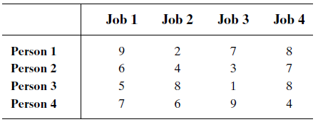
Example 3: The Assignment Problem
Explanation of the problem
There are n people who need to be assigned to n jobs, one person per job
The cost of assigning person i to job j is C[i,j]
Find an assignment that minimizes the total cost
Explanation of the algorithm
Generate all legitimate assignments,
compute their costs,
and select the cheapest one
n! assignments

Slide 26
Example 3: The Assignment Problem, Contd.
Assignment (columns) | Total Cost
1,2,3,4 | 9+4+1+4 = 18
1,2,4,3 | 9+4+8+9 = 30
1,3,2,4 | 9+3+8+4=24
1,3,4,2 | 9+3+8+6=26
1,4,2,3 | 9+7+8+9=33
1,4,3,2 | 9+7+1+6=23
2,1,3,4 | 6+2+1+4 = 13
2,1,4,3 | …
2,3,1,4
2,3,4,1
2,4,1,3
2,4,3,1
…
Analysis of the algorithm
One can pick the best person for the job
by looking at the minimum in each column
This can reduce the search space
Time efficiency is O(n!)
permutations of persons (to jobs)
Number of possible assignment = 24 = 4!
https://saade.perso.math.cnrs.fr/HungarianAlgorithm/HungarianAlgorithm.html
Notes:
We compute Big O and not Theta in the worst case since we are considering solutions not cases

Slide 27
Final Comments on Exhaustive Search
Exhaustive-search algorithms run in a realistic (reasonable) amount of time only on very small instances
In many cases, exhaustive search or its variation is the only known way to get exact solution
In some cases, there are much better alternatives!
Euler circuits
shortest paths
minimum spanning tree
assignment problem
The Hungarian method for solving the assignment problems runs in O(n^3) time
https://www.thesaurus.com/browse/realistic; https://saade.perso.math.cnrs.fr/HungarianAlgorithm/HungarianAlgorithm.html
Notes:
The Hungarian method is defined as a combinatorial optimization technique that solves the assignment problems in polynomial time

